Slide 1
Robot Controller
Prepared by: ECE 532 Design Team 9
2017/2/10

Slide 2
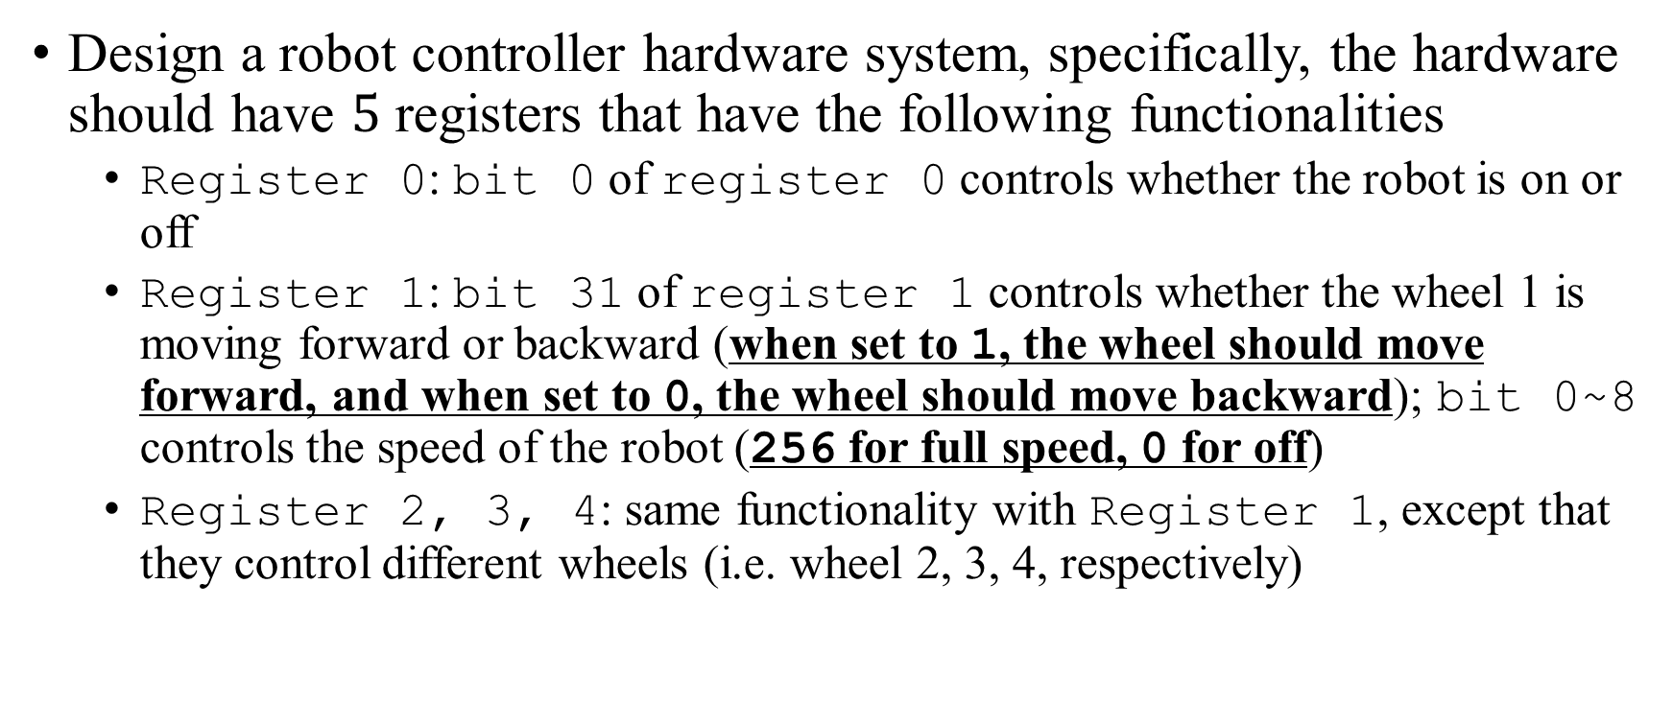
Design Description
Design a robot controller hardware system, specifically, the hardware should have $5$ registers that have the following functionalities
Register 0: bit 0 of register 0 controls whether the robot is on or off
Register 1: bit 31 of register 1 controls whether the wheel 1 is moving forward or backward (when set to 1, the wheel should move forward, and when set to 0, the wheel should move backward); bit 0~8 controls the speed of the robot (256 for full speed, 0 for off)
Register 2, 3, 4: same functionality with Register 1, except that they control different wheels (i.e. wheel 2, 3, 4, respectively)

Slide 3

SystemVerilog Testbench
The SystemVerilog testbench developed covers the following cases
Moving forward at full speed
Moving backward at half speed
Moving forward at $70\%$ speed
Moving backward at speed $0$

Slide 4
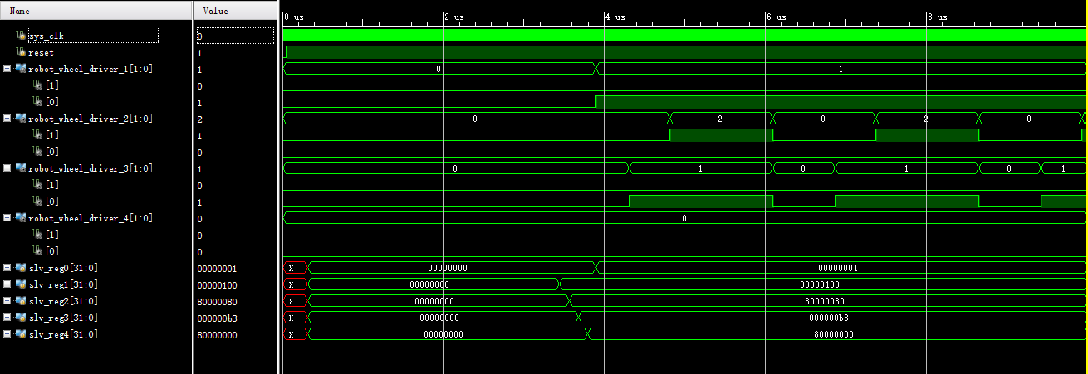
Simulation Diagram

Slide 5
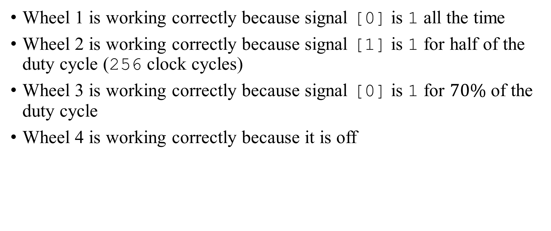
Comment
Wheel 1 is working correctly because signal [0] is 1 all the time
Wheel 2 is working correctly because signal [1] is 1 for half of the duty cycle (256 clock cycles)
Wheel 3 is working correctly because signal [0] is 1 for $70\%$ of the duty cycle
Wheel 4 is working correctly because it is off

